Slide 1
Dynamic Functional Bandwidth Kernel-based SVM : An Efficient Approach for Functional Data Analysis
IEMIS 2020
Paper Id: 220
Authors
1. Anima Pramanik
Department of Industrial & Systems Engineering, IIT Kharagpur, India
e-mail: apramanik17@gmail.com
2. Vikram Nande
Department of Mechanical Engineering, IIT Kharagpur, India.
e-mail: vikramnande@gmail.com
3. Arka Shankar Pradhan
Department of Industrial and Systems Engineering, IIT Kharagpur, India.
Email : arkashankar2003@gmail.com
4. Sobhan Sarkar(*Corresponding author)
Division of Management Science, Business School, The University of Edinburgh, UK.
e-mail: sobhan.sarkar@gmail.com; sobhan.sarkar@ed.ac.uk
5. J. Maiti
Department of Industrial & Systems Engineering, IIT Kharagpur, India.
e-mail: jhareswar.maiti@gmail.com
Presenters
Vikram Nande
Department of Mechanical Engineering, IIT Kharagpur, India
Email: vikramnande@gmail.com
Ph. No.: 7477858594
Arka Shankar Pradhan
Department of Industrial and Systems Engineering, IIT Kharagpur, India
Email : arkashankar2003@gmail.com
Ph. No.: 7477309464
Date of Presentation: 03/07/2020

Slide 2
Contents
Introduction
Related Works
Motivation
Kernels Used in SVM
Gaussian Kernel
Contribution
Proposed Methodology
Datasets Used
Results and Discussion
Limitations
Future Score of Work
Conclusion
References

Slide 3
Introduction
Functional data analysis refers to the standard multivariate analysis over the data having infinite dimension.
SVM algorithm has a kernel which is a mathematical function. For SVM, utilizes the functional behavior of data by converting classical kernel to functional kernel.
The conventional kernel of SVM is converted to functional bandwidth kernel and the results can be compared with state of the art techniques.

Slide 4
Related works
The functional nature of the data is considered in Kästner, Hammer, Biehl, and Villmann (2012) , generalizing the work done in the multivariate case in Hammer and Villmann (2002) ; Sato and Yamada (1996) .
For SVM, ( Rossi & Villa, 2006 ) exploits the functional behavior of the data by using the so called projection-based kernels.

Slide 5
Motivation
In the classic Gaussian kernel, the value of bandwidth parameter is same for all the attributes all over the process; thereby making the process static.
When EDA is done, we need to remove the highly correlated features in order to remove the collinearity and reduce the computational time.
But, finding the correlation of each attribute with the other attribute is a computationally expensive task in itself.
Hence by assigning the functional bandwidth parameter to each attribute correctly weighs each attribute, without further increase in computational time.

Slide 6
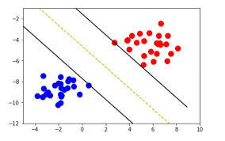
Support Vector Machine (SVM)
A Support Vector Machine (SVM) is a discriminative classifier formally defined by a separating hyperplane. In other words, given labeled training data (supervised learning), the algorithm outputs an optimal hyperplane which categorizes new examples.

Slide 7
Kernels used in SVM
SVM algorithms uses a set of mathematical functions that are defined as the kernel. The function of kernel is to take data as input and transform it into the required form.
Various types of kernel are:
(i) Linear Kernel
(ii) Non-Linear Kernel
(iii) Gaussian (or Radial Basis Function) Kernel
(iv) Sigmoid Kernel

Slide 8
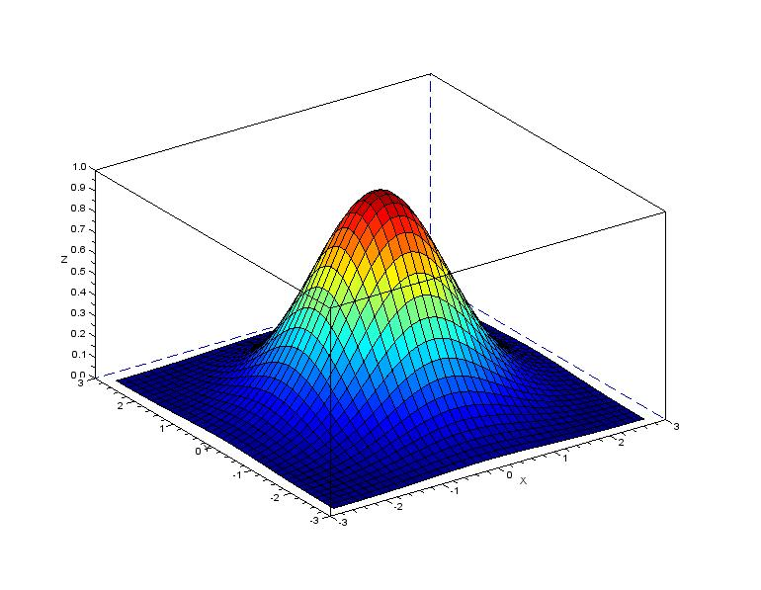
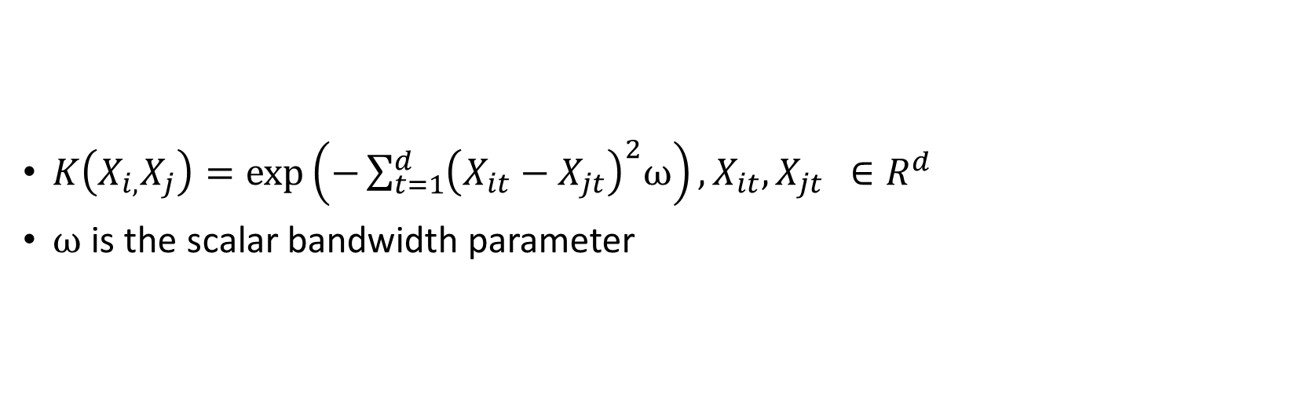
Gaussian Kernel
$K\left(X_{i,}X_{j}\right)=\exp\left(−\sum_{t=1}^{d}{{\left(X_{it}−X_{jt}\right)}^{2}ω}\right), X_{it}, X_{jt } ∈R^{d}$
$ω$ is the scalar bandwidth parameter

Slide 9
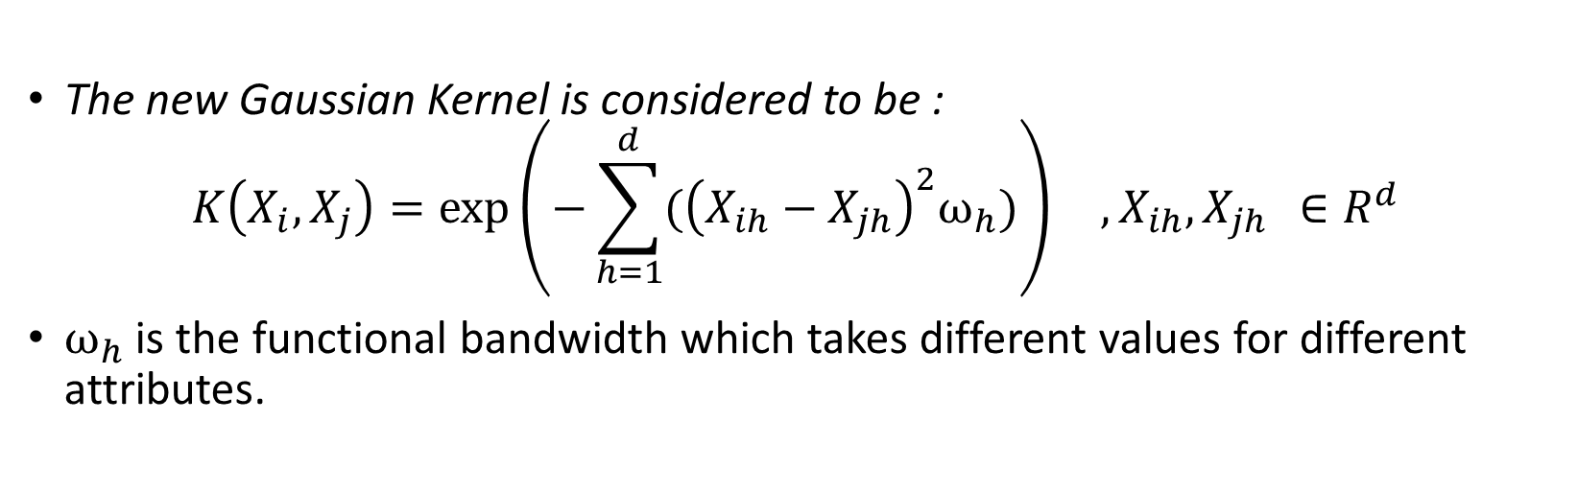
Contribution
The new Gaussian Kernel is considered to be :
$$K\left(X_{i},X_{j}\right)=\exp\left(−\sum_{h=1}^{d}{{(\left(X_{ih}−X_{jh}\right)}^{2}ω_{h}})\right) ,X_{ih}, X_{jh } ∈R^{d}$$
$ω_{h}$ is the functional bandwidth which takes different values for different attributes.

Slide 10
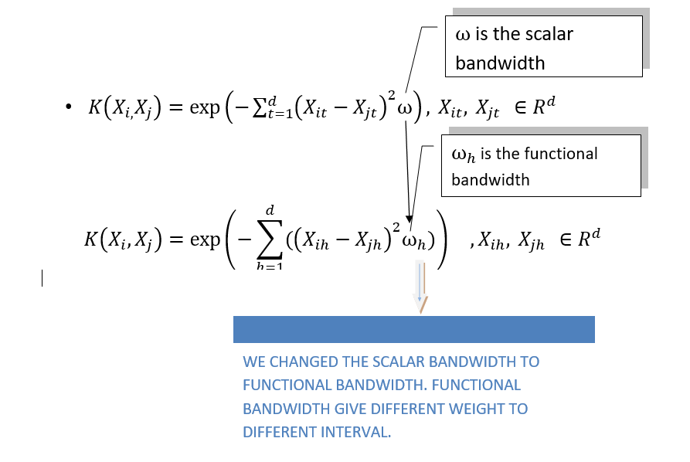
Contribution (Contd.)

Slide 11
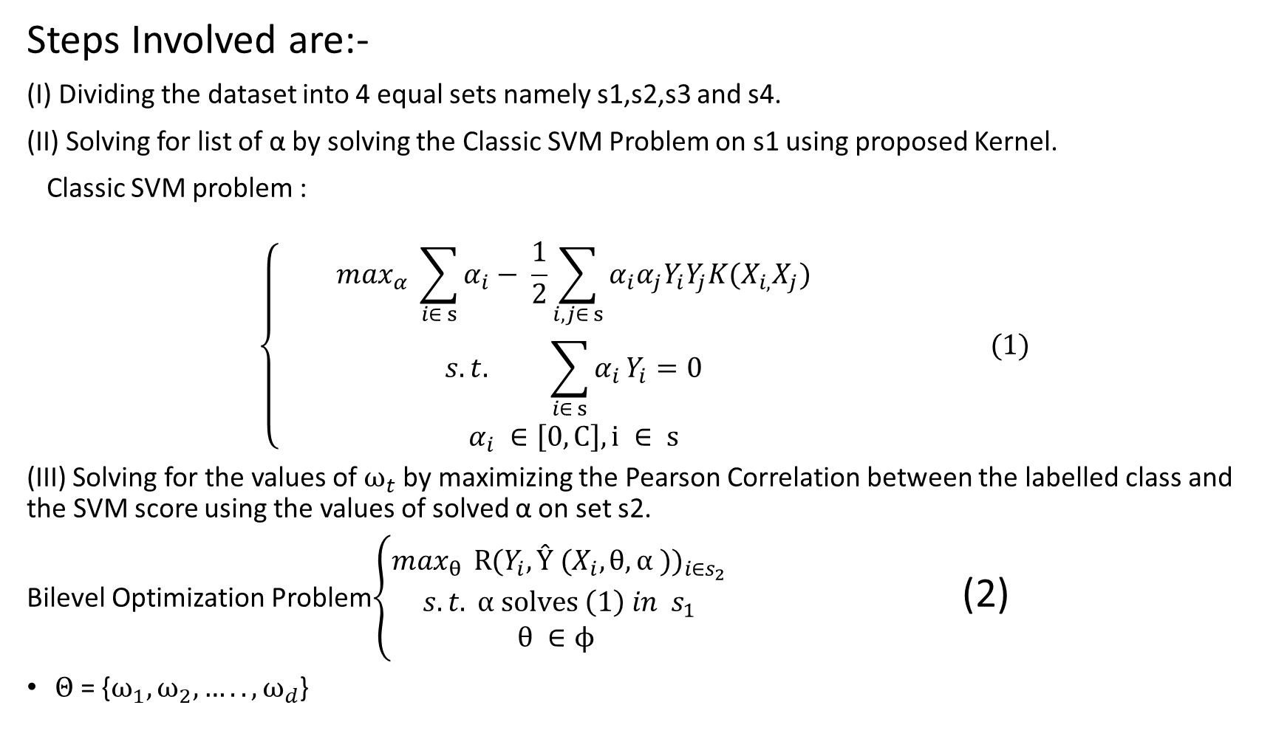
Proposed Methodology
Steps Involved are:-
(I) Dividing the dataset into 4 equal sets namely s1,s2,s3 and s4.
(II) Solving for list of α by solving the Classic SVM Problem on s1 using proposed Kernel.
Classic SVM problem :
$$\left\{ \begin{aligned}\max_{α} \sum_{i∈ s}{α_{i}− \frac{1}{2}\sum_{i,j∈ s}{α_{i}α_{j}Y_{i}Y_{j}K(X_{i,}X_{j})}} \\ s.t. \sum_{i∈ s}{α_{i}}Y_{i}=0 \\ α_{i} ∈\left[0,C\right], i ∈ s\end{aligned} (1)\right.$$
(III) Solving for the values of $ω_{t}$ by maximizing the Pearson Correlation between the labelled class and the SVM score using the values of solved α on set s2.
Bilevel Optimization Problem$\left\{\begin{aligned}\max_{θ } {R(Y_{i}, Ŷ (X_{i}, θ, α ))}_{i∈s_{2}} \\ s.t. α solves \left(1\right) in s_{1} \\ θ ∈ϕ \end{aligned}\right.$ (2)
$Θ$ = {$ω_{1},ω_{2},…..,ω_{d}$}

Slide 12

Proposed Methodology (Contd.)
(IV) Checking for the best value of regularization parameter C by selecting the value by using a grid search on different values. The value of C having maximum accuracy on s3 is selected.
SVM Score : Ŷ (X , $θ, α$) = $\sum_{iεs}{∝_{i}Y_{i}K\left(X,X_{i}\right) (3)}$
$α=${$∝_{1 },∝_{2 }$,……., $∝_{s}$}
$Θ$ = {$ω_{1},ω_{2},…..,ω_{d}$}
(V) Overall Accuracy is then calculated on s4.

Slide 13
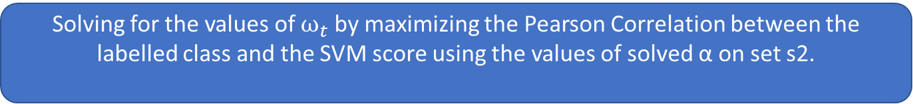
Proposed methodological flowchart
Dividing the dataset into 4 equal sets namely s1,s2,s3 and s4.
Solving for list of α by solving the Classic SVM Problem on s1 using proposed Kernel.
Solving for the values of $ω_{t}$ by maximizing the Pearson Correlation between the labelled class and the SVM score using the values of solved α on set s2.
Checking for the best value of regularization parameter C by selecting the value by using a grid search on different values. The value of C having maximum accuracy on s3 is selected.
Overall Accuracy is then calculated on s4.

Slide 14
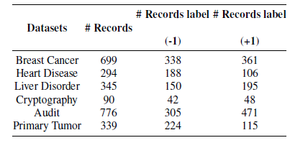
Dataset Used:
Our methodology is used on six datasets namely:
Breast Cancer Wisconsin.
Heart Disease
Liver Disorder
Cryptography
Audit
Primary Tumour

Slide 15
Accuracy evaluation
Results and Discussions

Slide 16
Results and Discussions (Contd.)
The maximum accuracy we obtained here using this method on different datasets is as follows:
Breast Cancer : 88.03% for h=4
Heart Disease : 89.38% for h=5
Liver Disorder : 90.25% for h=3
Audit : 88.72% for h=2
Cryptography : 86.56% for h= 7
Primary Tumour : 89.41% for h=5
The algorithm works efficiently with less running time.
The different class labels seem to be easy to identify depending on subintervals, and therefore our strategy makes easier such separation.

Slide 17

Key findings
The algorithm works efficiently with reportedly less running time. The different classes are easily identified depending on the sub-intervals, and hence, our proposed method creates the separation easier.
01
It is observed that we obtain the highest accuracies when the value of h<=7. Also, we observe that the training takes the maximum amount of time.
02

Slide 18
Limitations
There is increase in running time because of the problems being used are nested here. This is because the optimal solution for simple models is obtained which is then used by the complex optimization problems.
Results may not be very accurate for some non-functional data as functional kernel uses the functional behavior of the data.

Slide 19
Future Scope of work
This method can be tried for multiclass classification.
This technique of using functional bandwidth can be extended to be used in Polynomials and Piecewise Polynomials.
By using different and better optimization techniques on the proposed methodology can further improve the accuracy.

Slide 20
Conclusions
Our algorithm clearly outperforms the k-NN and classic SVM classification.
In this paper we have shown that SVM for data can be improved by tuning functional bandwidth, thus yielding the most relevant intervals in terms of the classification rate .
The misclassification rate is minimized.
Here the correlation between labels and scores are optimized, allowing us to use gradient-based local search algorithms.

Slide 21
References
1. Rossi, F., Villa, N.: Support vector machine for functional data classification. Neurocomputing
2. Martin-Barragan, B., Lillo, R., Romo, J.: Interpretable support vector machines for functional data. European Journal of Operational Research 232(1), 146–155 (2014).
3. Laukaitis, A., Raˇckauskas, A.: Functional data analysis for clients segmentation tasks. European journal of operational research 163(1), 210–216 (2005).
4. Blanquero, R., Carrizosa, E., Jim´enez-Cordero, A., Mart´ın-Barrag´an, B.: Functional bandwidth kernel for support vector machine with functional data: An alternating optimization algorithm. European Journal of Operational Research 275(1), 195–207 (2019).
5. Blanquero, R., Carrizosa, E., Jim´enez-Cordero, A., Mart´ın-Barrag´an, B.: Variable selection in classification for multivariate functional data. Information Sciences 481, 445–462 (2019).
6. Berrendero, J.R., Cuevas, A., Torrecilla, J.L.: Variable selection in functional data classification: a maxima-hunting proposal. Statistica Sinica pp. 619–638 (2016).
7. Jacobson, S.H., Y¨ucesan, E.: Analyzing the performance of generalized hill climbing algorithms.Journal of Heuristics 10(4), 387–405 (2004).
8. Kadri, H., Duflos, E., Preux, P., Canu, S., Davy, M.: Nonlinear functional regression: a functionalrkhs approach (2010)
9. Xu, Y., Wang, L., Wang, S.y., Liu, M.: An effective teaching–learning-based optimization algorithm for the flexible job-shop scheduling problem with fuzzy processing time. Neurocomputing 148, 260–268 (2015).
10. Colson, B., Marcotte, P., Savard, G.: An overview of bilevel optimization. Annals of operations research 153(1), 235–256 (2007)

Slide 22
Thank you

